Slide 1
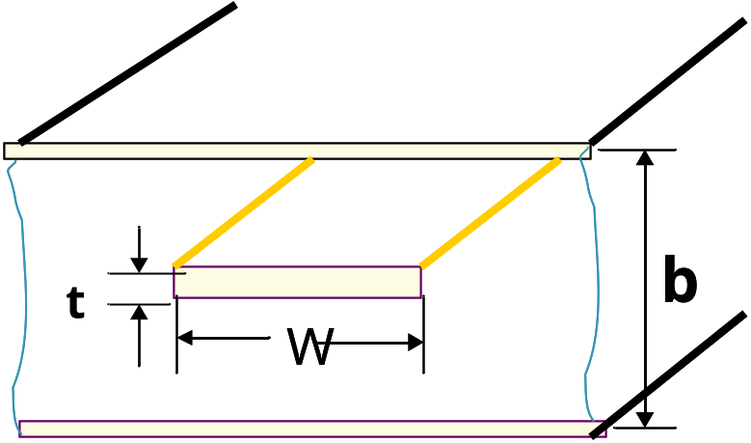
§4-6 Stripline
A planar-type of transmission line
Geometry: A thin conducting strip of width W is centered between two wide conducting ground planes of separation b, and the entire region between the ground planes is filled with a dielectric
Can support TEM and TE/TM modes

Slide 2
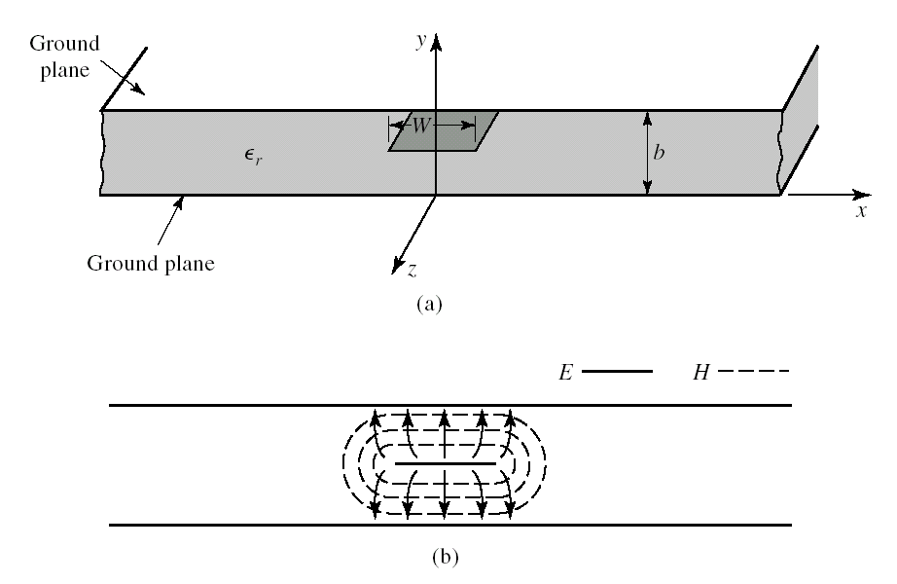
Stripline transmission line. (a) Geometry. (b) Electric and magnetic field lines.
§4-6 Stripline

Slide 3
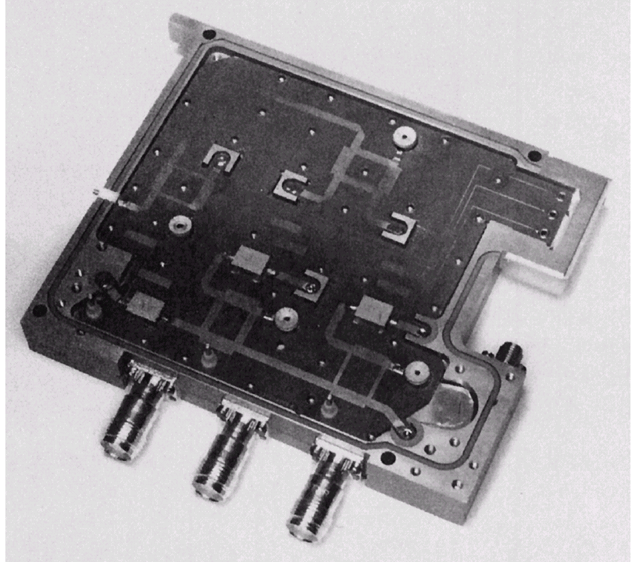
Photograph of a stripline circuit assembly, showing four quadrature hybrids, open-circuit tuning stubs, and coaxial transitions.
§4-6 Stripline

Slide 4
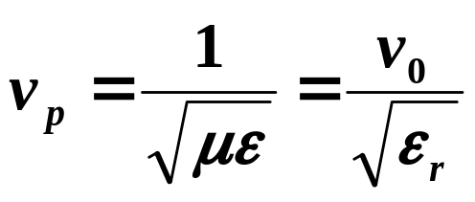
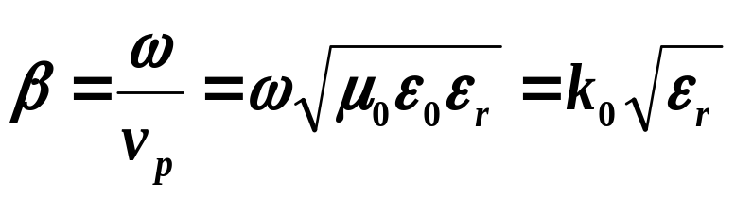
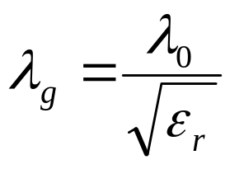
§4-6 Stripline
1、Formulas for propagation constant, Characteristic Impedance and Attenuation of TEM mode
(1) Phase velocity
（2）Propagation constant
（3） Guide wavelength

Slide 5
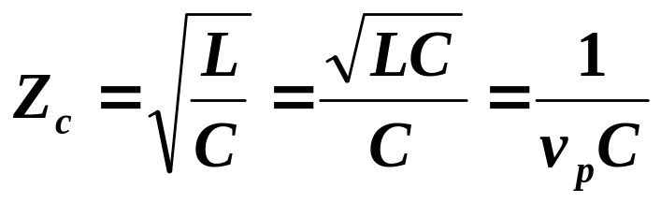
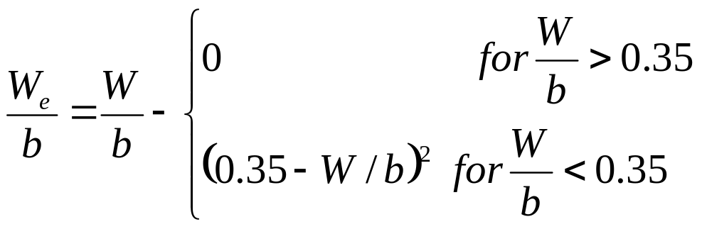
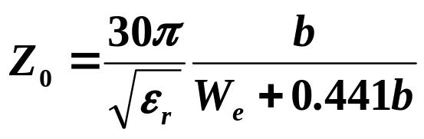
§4-6 Stripline
(4) Characteristic impedance
Where L and C are the inductance and capacitance per unit length of the line, Thus, we can find Zc if we know C
If a zero strip thickness, simple formulas have been developed by curve fitting to the exact solution
Where We is the effective width of the center conductor given by

Slide 6
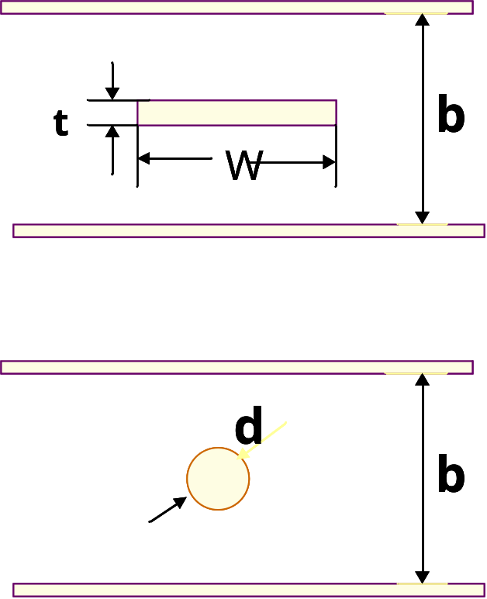
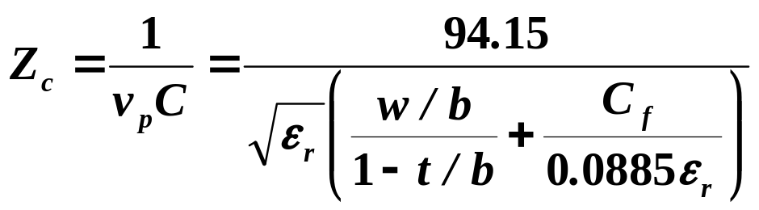
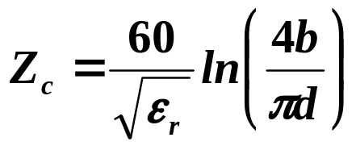
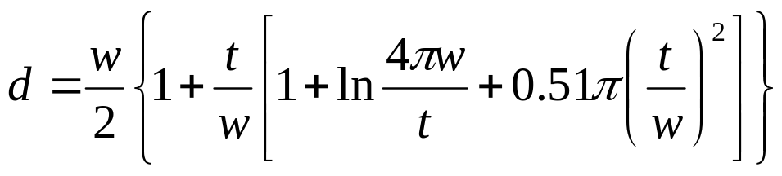
§4-6 Stripline
If strip thickness is not zero
(a) w/(b-t)≥0.35)
(2) w/(b-t)<0.35
When t/w≤0.11

Slide 7
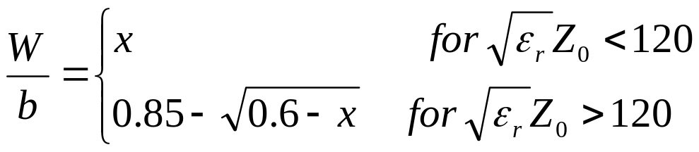
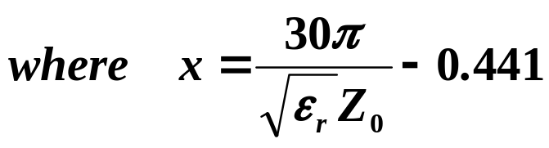
§4-6 Stripline
Find the strip width, given the characteristic impedance (and height b and permittivity ε_{r} ),

Slide 8
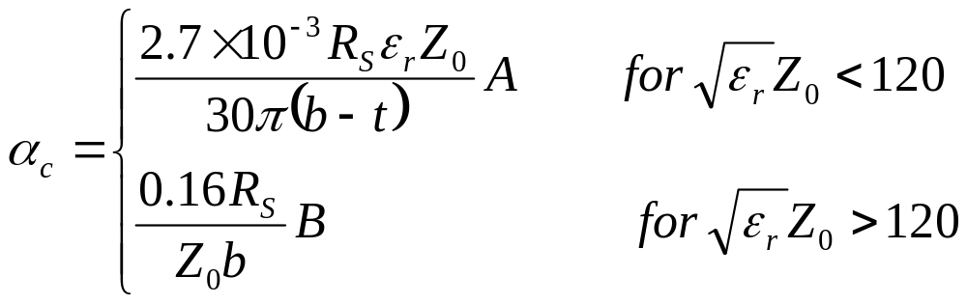
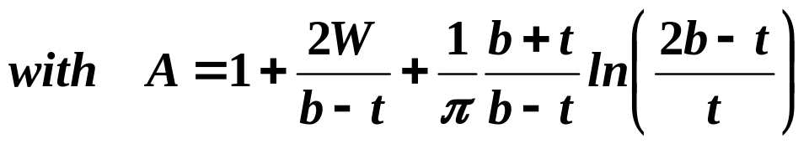
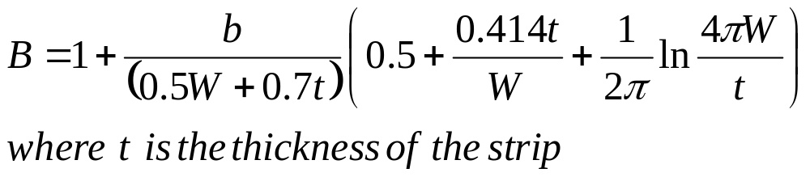
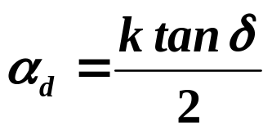
§4-6 Stripline
(5) Attenuation

Slide 9
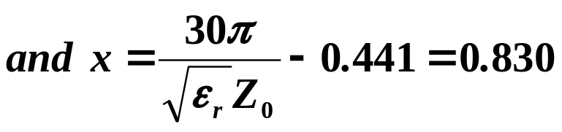

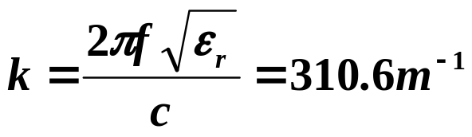
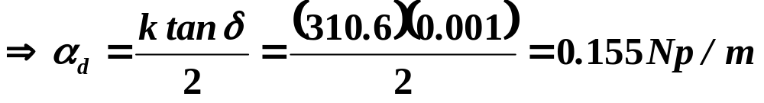
§4-6 Stripline
Example： Stripline Design
Find the width for a 50Ω copper stripline conductor, with b=0.32cm and εr=2.20. If the dielectric loss tangent is 0.001 and the operating frequency is 10GHz, calculate the attenuation in dB/λ. Assume conductor thickness t=0.01mm
Solution

Slide 10
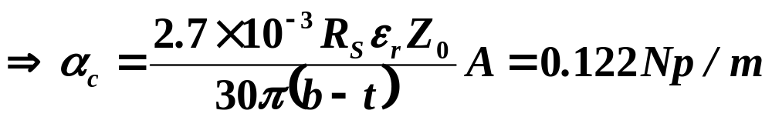



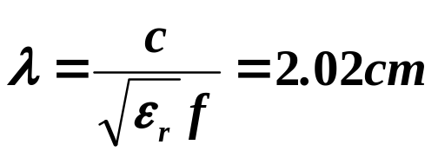
§4-6 Stripline
At 10GHz, the wavelength on the stripline is
So in terms of wavelength the attenuation is

Slide 11
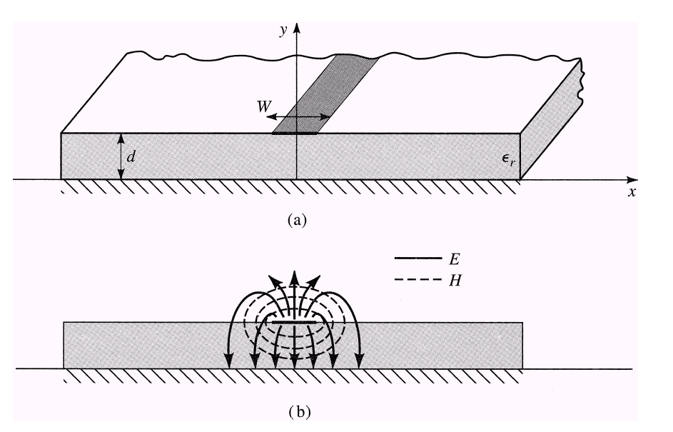
§4-7 Microstrip
Microstrip transmission line. (a) Geometry. (b) Electric and magnetic field lines.

Slide 12
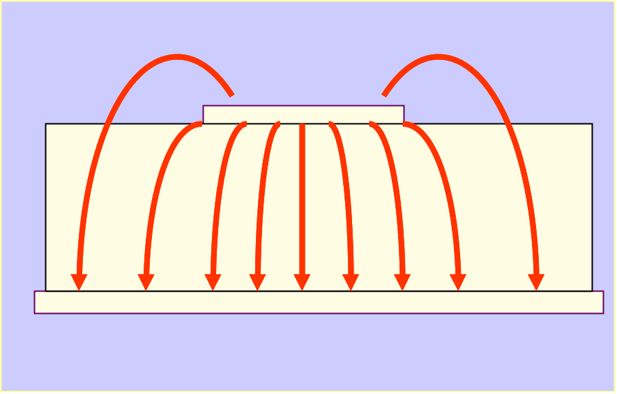
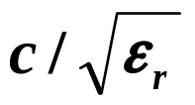
§4-7 Microstrip
Microstrip line cannot support a pure TEM wave
  Microstrip has some (usually most) of its field lines in the dielectric region, concentrated between the strip conductor and the ground plane, and some fraction in the air region above the substrate.
  The phase velocity of TEM fields in the dielectric region would be
But the phase velocity of TEM fields in the air region would be c.
Thus, a phase match at the dielectric-air interface would be impossible to attain for a TEM-type wave.

Slide 13
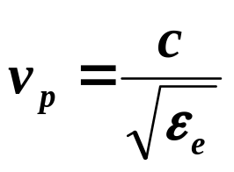
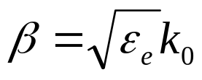

§4-7 Microstrip
In actuality, the exact fields of a microstrip line constitute
a hybird TM-TE wave.
In most practical applications, however, the dielectric substrate is electrically very thin (d<<λ), and so the fields are quasi-TEM.
In other words, the fields are essentially the same as those of the static case. Thus, good approximations for the phase velocity, propagation constant, and characteristic impedance can be obtained from static or quasi-static solutions.
ε_{e} is the effective dielectric constant of the microstrip line
dependent on the substrate thickness, d, and conductor width, W

Slide 14
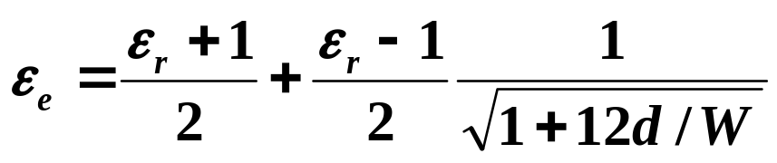
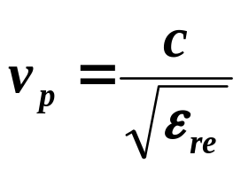
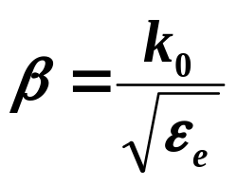
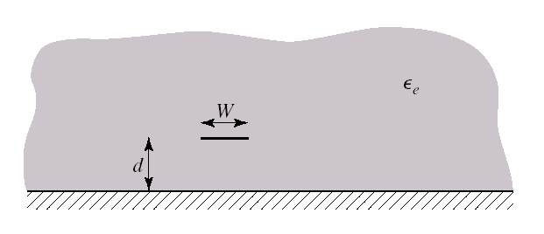
§4-7 Microstrip
1、Formulas for Effective Dielectric constant, Characteristic Impedance and Attenuation
The effective dielectric constant is given approximated by
Fig. Equivalent geometry of quasi-TEM microstrip line, where the dielectric slab of thickness d and relative permittivity ε_{r} has been replaced
with a homogeneous medium of effective relative permittivity, ε_{e}.

Slide 15
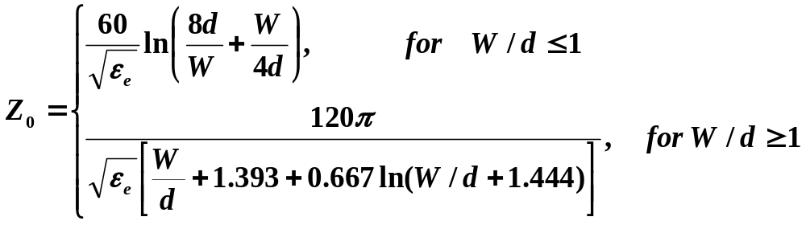
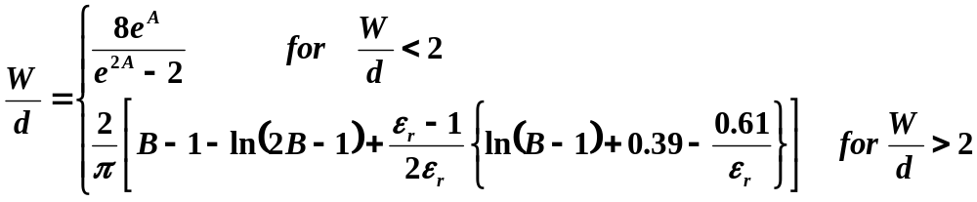
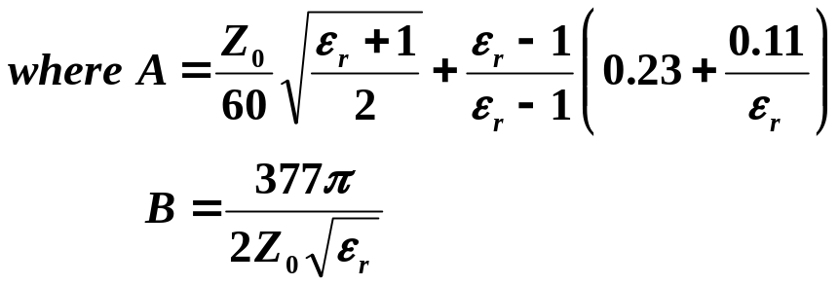
§4-7 Microstrip
Characteristic impedance
For a given Z₀ and dielectric constant

Slide 16
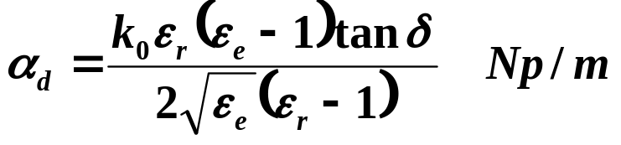
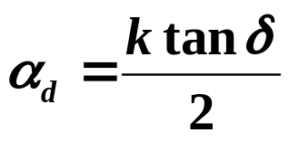
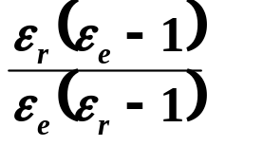
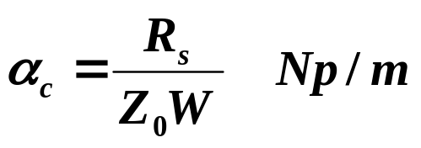
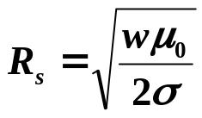
§4-7 Microstrip
Considering microstrip as a quasi-TEM line, the attenuation due to dielectric loss can be determined as
Multiplying by a “filling factor”
The attenuation due to conductor loss is given approximately by

Slide 17

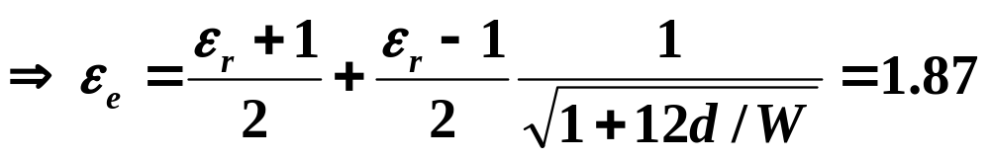
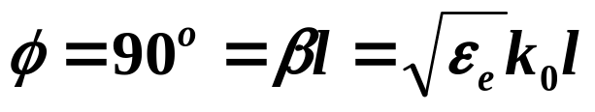
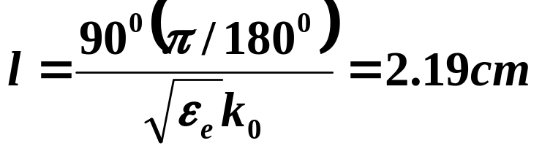
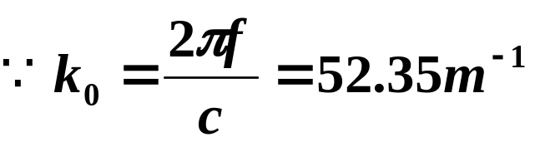
§4-7 Microstrip
Example： Microstrip Design
Calculate the width and length of a microstrip line for Z0=50 Ω and a 90⁰ phase shift at 2.5GHz. The substrate thickness is d=0.127cm, withεr=2.20.
Solution
Find W/d for Z0=50Ω, and initially guess that W/d>2
(Otherwise, assume W/d<2)
The line length, l, for a 90⁰ phase shift is found as

Slide 18
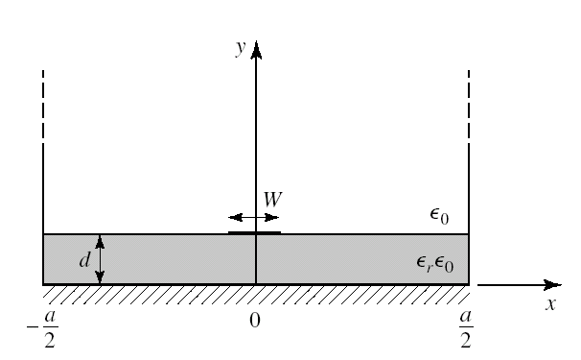
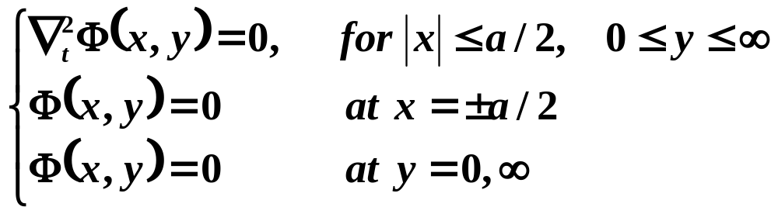
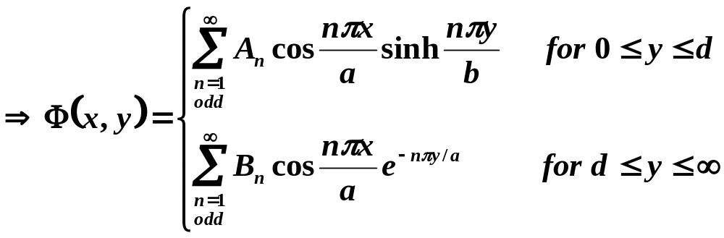
§4-7 Microstrip
2、An approximate electrostatic Solution
It is convenient to place conducting sidewalls on the microstrip line. The sidewalls are placed at x=±a/2, where a>>d, so that the walls should not perturb the field lines localized around the strip conductor.

Slide 19
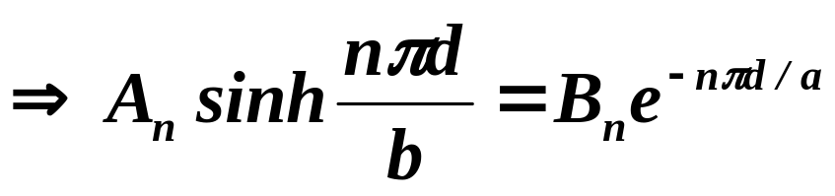
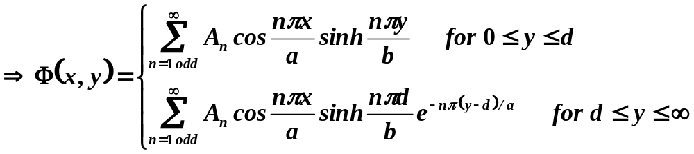

§4-7 Microstrip
Potential must be continuous at y=d
The remaining constant, An, can be found by considering the surface charge density on the strip,

Slide 20



§4-7 Microstrip
Then the surface charge density on the strip at y=d is
Approximate the charge density on the microstrip line by a uniform distribution:

Slide 21



§4-7 Microstrip
The voltage of the strip relative to the ground plane is
The total charge, per unit length, on the center strip is
So the static capacitance per unit length of the microstrip line is :

Slide 22


§4-7 Microstrip
To find the effective dielectric constant, we consider two cases of capacitance,
  Let C=capacitance per unit length of the microstrip line with a dielectric substrate (ε_{r}≠1) ;
  Let C₀=capacitance per unit length of the microstrip line with an air dielectric (εr=1) ;
Since capacitance is proportional to the dielectric constant of the material homogeneously filling the region around the conductors, we have that
Characteristic impedance

